Slide 1
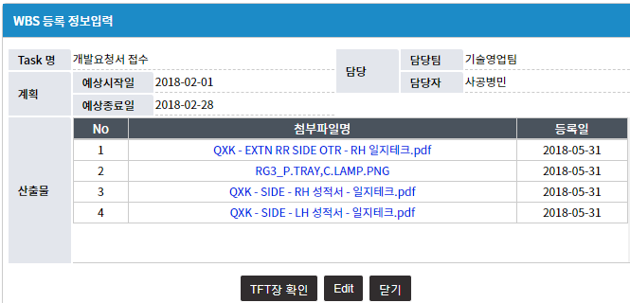
RG3 WBS

Slide 2

QX WBS

Slide 3
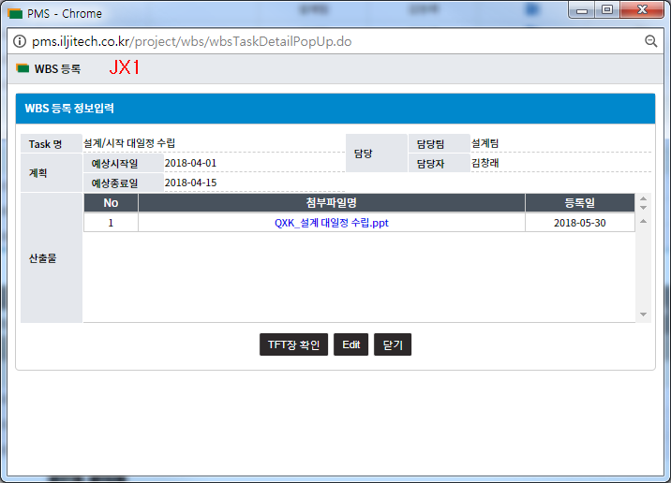
JX1 WBS

